Slide 1
Pantip, Facebook, Kaidee Performance
Jan 27, 2017 – Dtac Data Science

Slide 2
Performance by Offer, Device and Channel

Slide 3
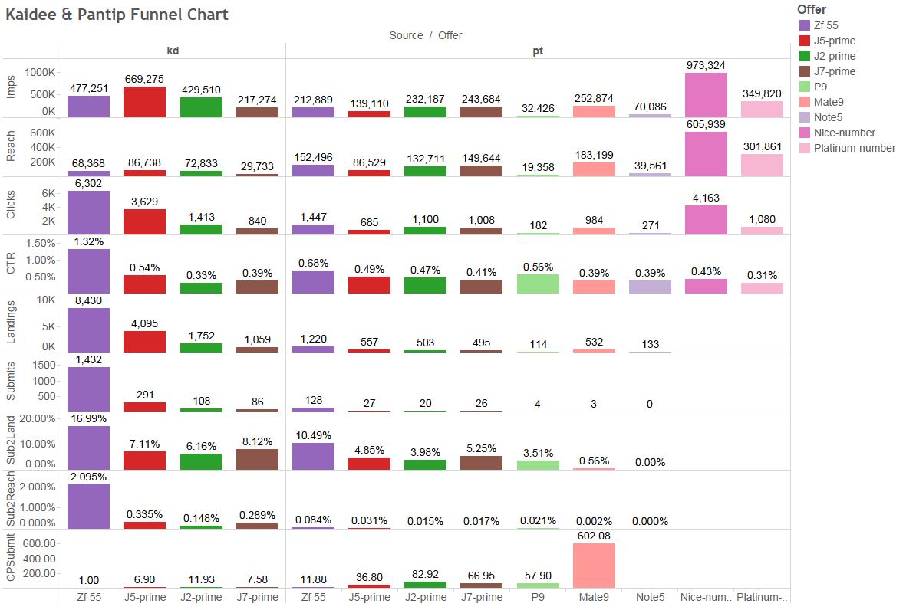
Kaidee & Pantip Full Funnel
Impressions, Reach, Clicks, CTR, Landings, Submits, Submit Rates, Cost per Submit
Data from Jan 1 – Jan 24, 2017
CTR is not enough for considering the performance, the Submit to Landing rate (Sub2Land) is also important
The Submit to Reach rate (Sub2Reach) for Pantip is much lower than Kaidee
Huawei Mate 9 offer has a very small Sub2Reach (usual trend for expensive offers)
Action point:
Must find an offer that interests high-end targets
The submits here refer to submit botton clicks on the landing pages.

Slide 4
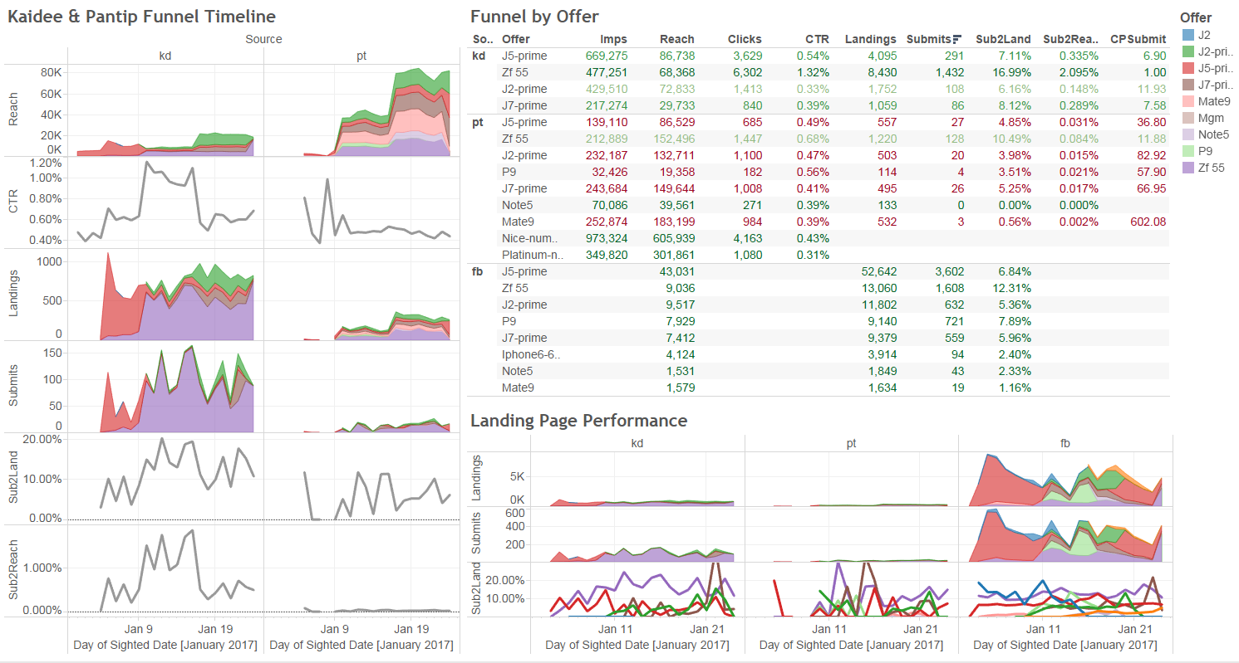
Kaidee, Pantip and Facebook Funnel Timeline
Comparing performance by offer and channel
2
1
Most of submits are from Facebook, very small number of submits from Pantip despite high reach.
Same offers that perform well on Kaidee and Facebook do not perform well on Pantip.

Slide 5
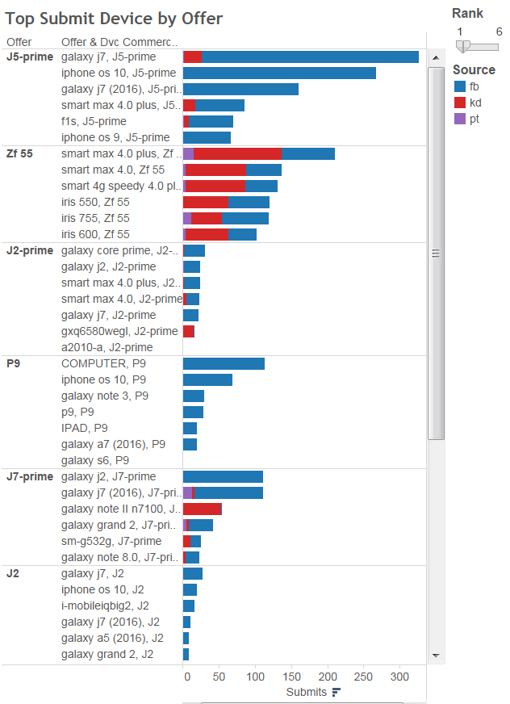
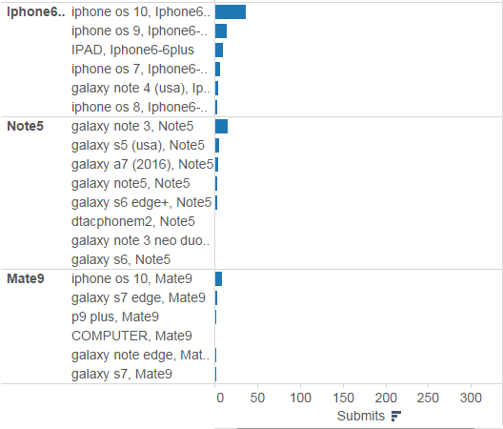
Top Submit Device Funnel by Offer
Targets have sparse interests, iPhones also opt for Samsung and Huawai
No clear trend on the phone price ranges that interest the targets.
They can opt for higher-end phones, lower-end phones, same range of phones, change the brand (Apple -> Samsung or Huawei, Samsung -> Apple)

Slide 6
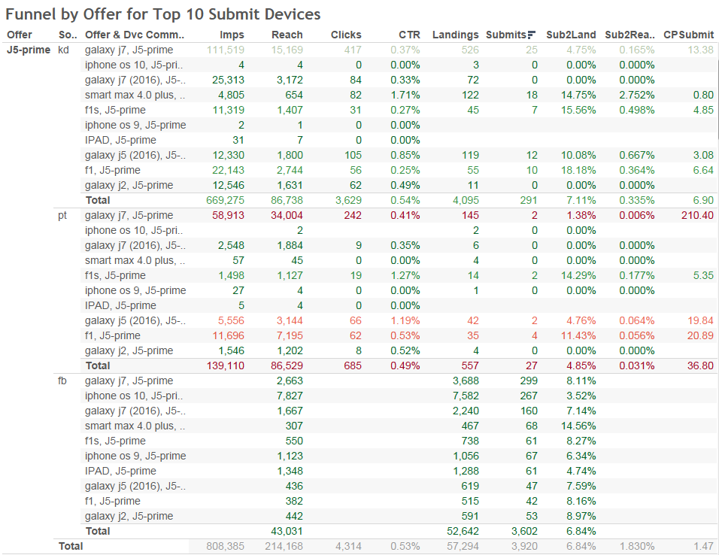
Top Submit Device Funnel by Offer and Channel
Same offer and same targets’ device perform differently on different channel

Slide 7
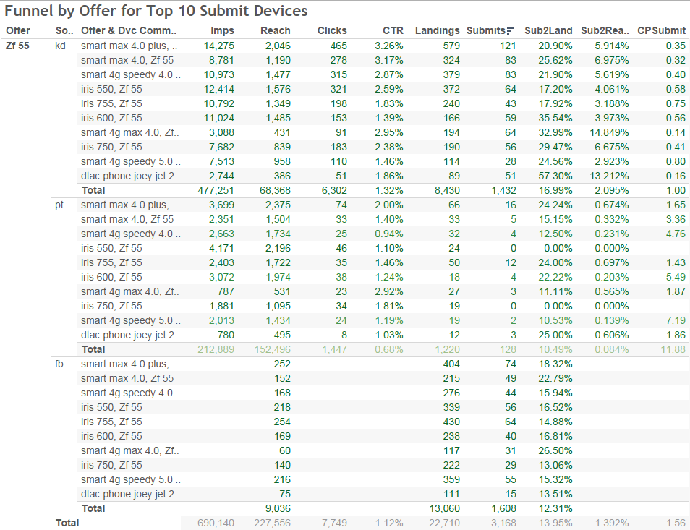
Top Submit Device Funnel by Offer and Channel
Same offer and same targets’ device perform differently on different channel
Very high success rate for Zenfone 5.5 offer on Kaidee
2% of Submit2Reach
CPSubmit of 1 USD

Slide 8
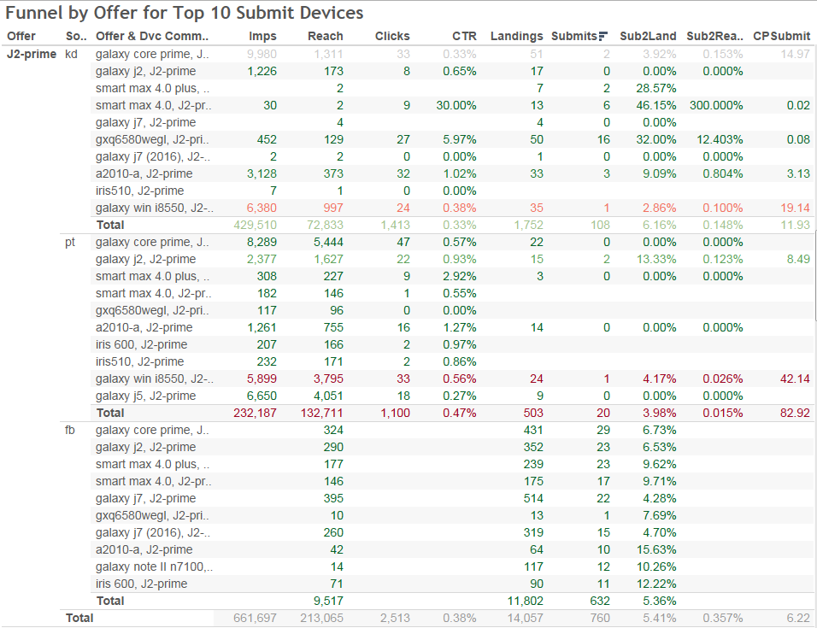
Top Submit Device Funnel by Offer and Channel
Same offer and same targets’ device perform differently on different channel

Slide 9
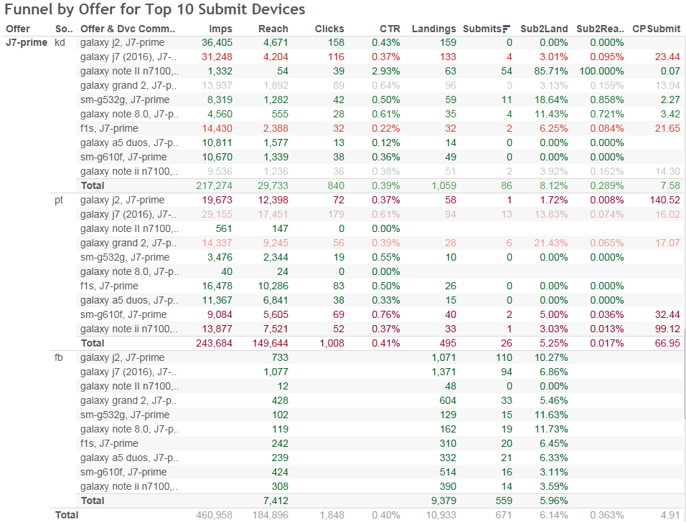
Top Submit Device Funnel by Offer and Channel
Same offer and same targets’ device perform differently on different channel

Slide 10
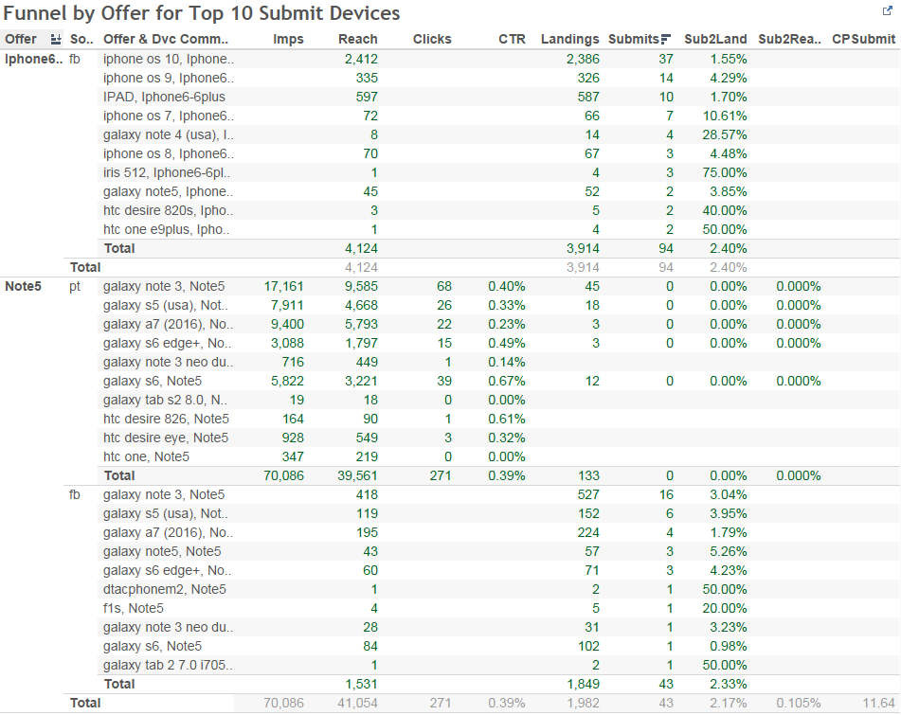
Top Submit Device Funnel by Offer and Channel
Same offer and same targets’ device perform differently on different channel
The lower the iOS the higher the submit2Land rate generally.

Slide 11
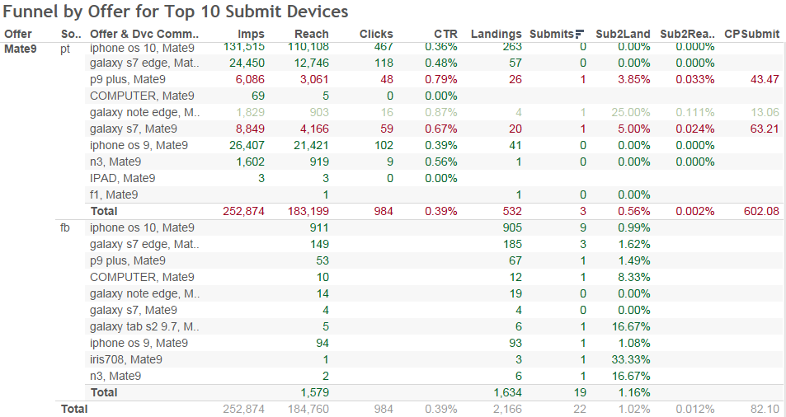
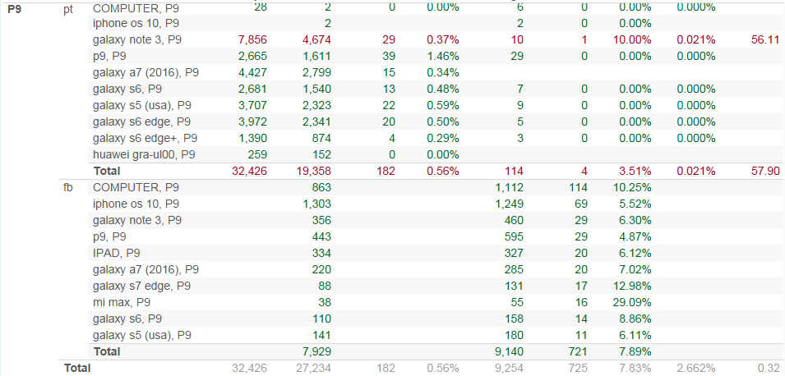
Top Submit Device Funnel by Offer and Channel
Same offer and same targets’ device perform differently on different channel

Slide 12
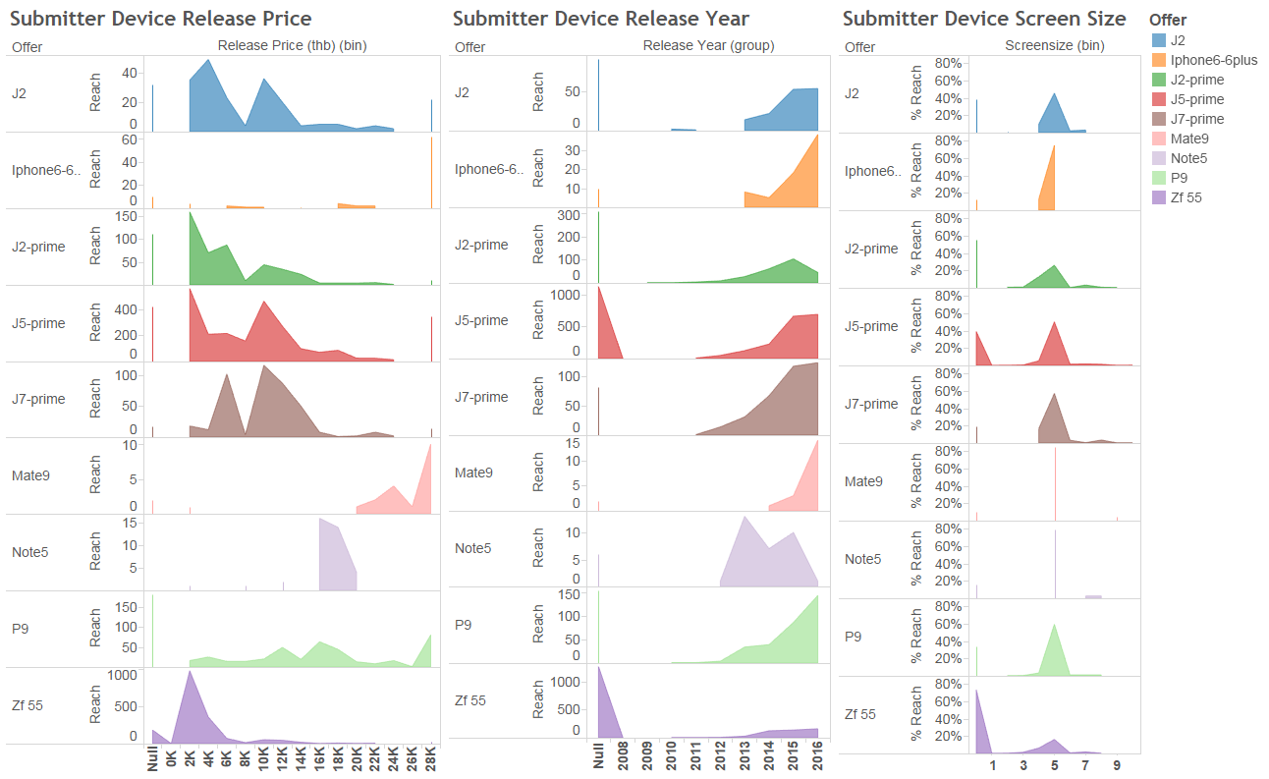
Top Submit Device Funnel by Offer
On which devices the offers well/ badly perform?

Slide 13
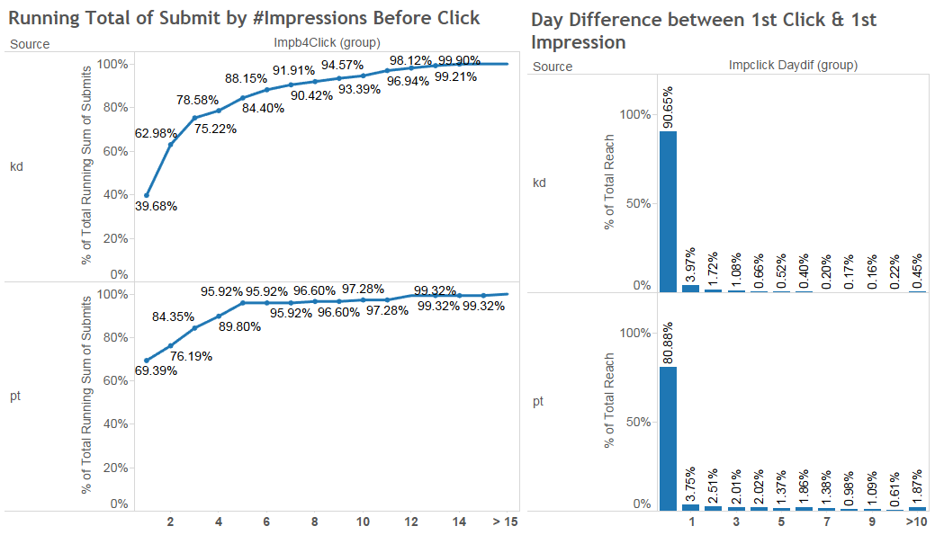
Optimal Impressions Cap for Kaidee and Facebook
88% of Kaidee submitters have <= 6 impressions before click
90% of Pantip submitters have <= 4 impressions before click

Slide 14
Pantip Performance by Room and Category

Slide 15
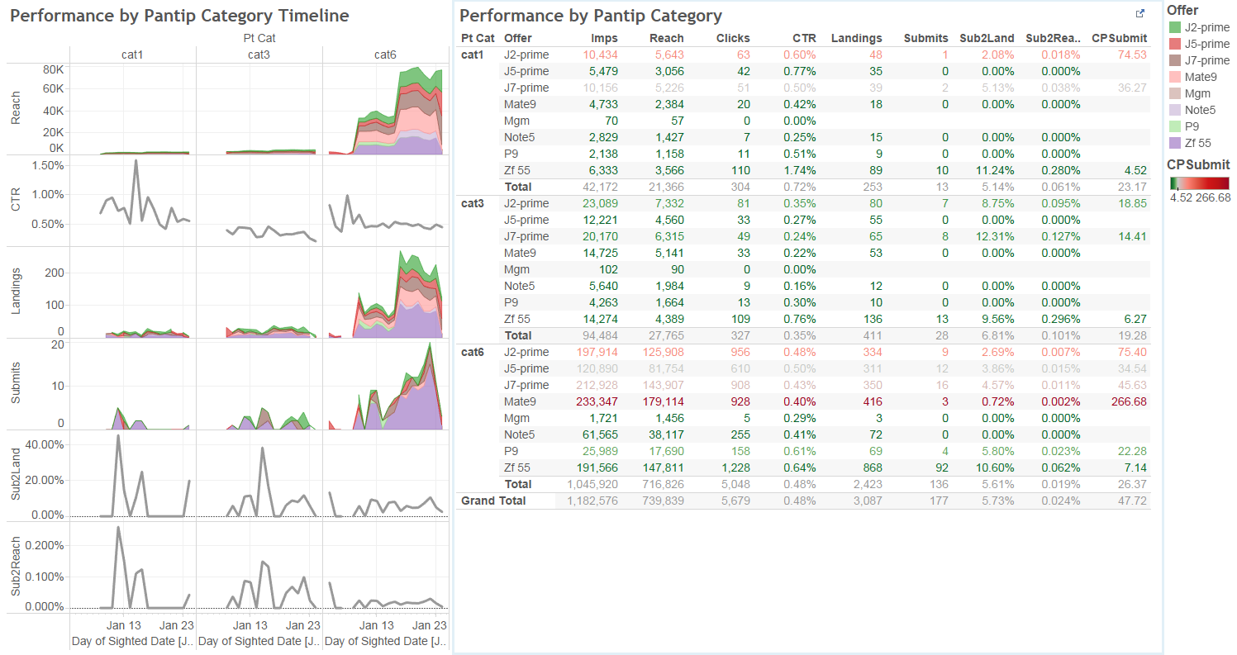
Pantip Performance by Category
Sub2Reach rate on Cat 3 is higher than Cat 1 despite the lower CTR

Slide 16
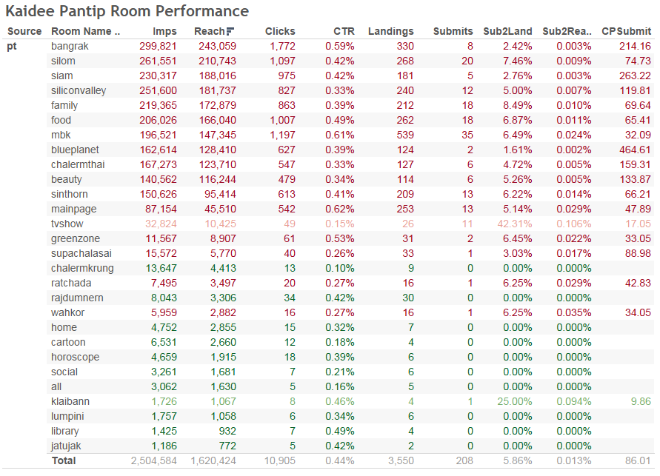
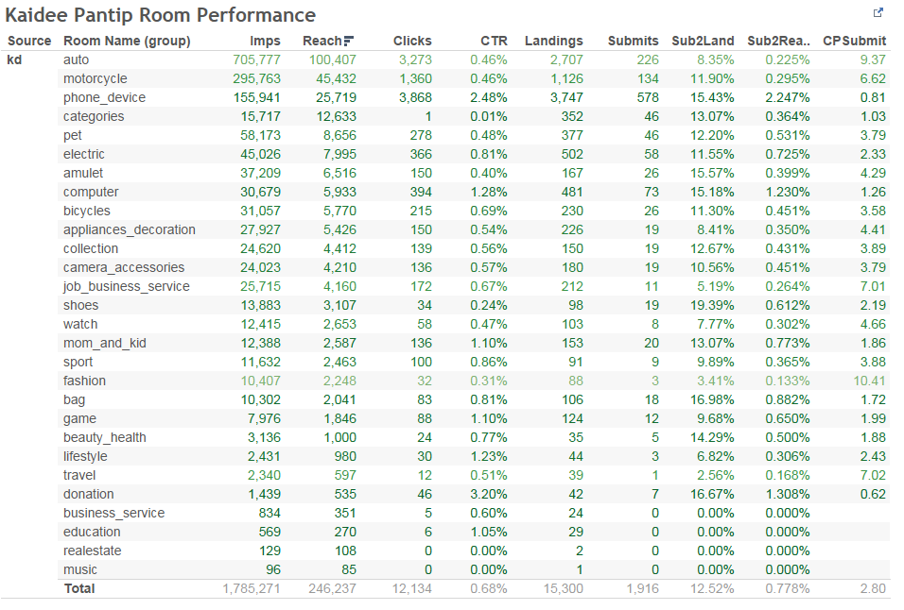
Kaidee and Pantip Performance by Room
Kaidee’s phone room performs better than Pantip’s MBK

Slide 17
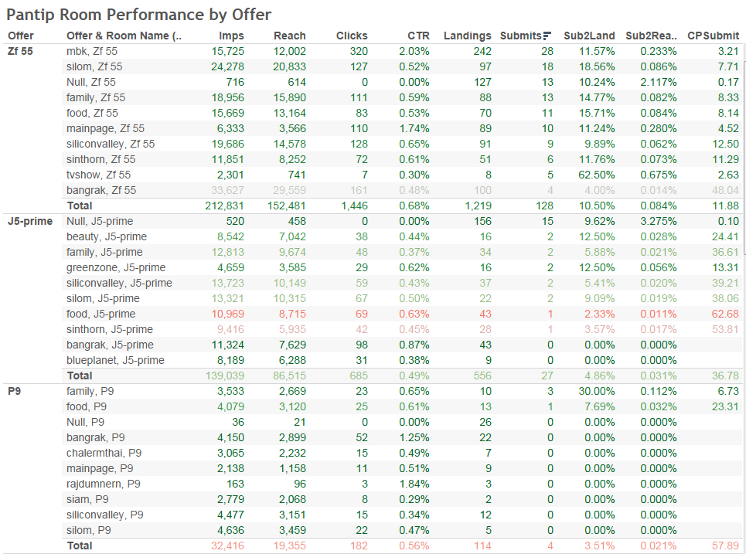
Pantip Room Performance by Offer
Relevant offers have more impact on performance than the room

Slide 18
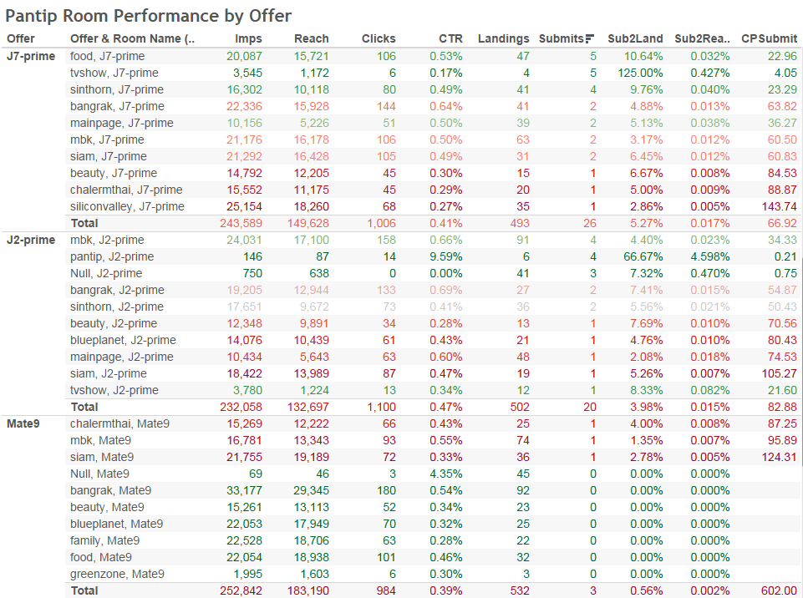
Pantip Room Performance by Offer
Relevant offers have more impact on performance than the room

Slide 19
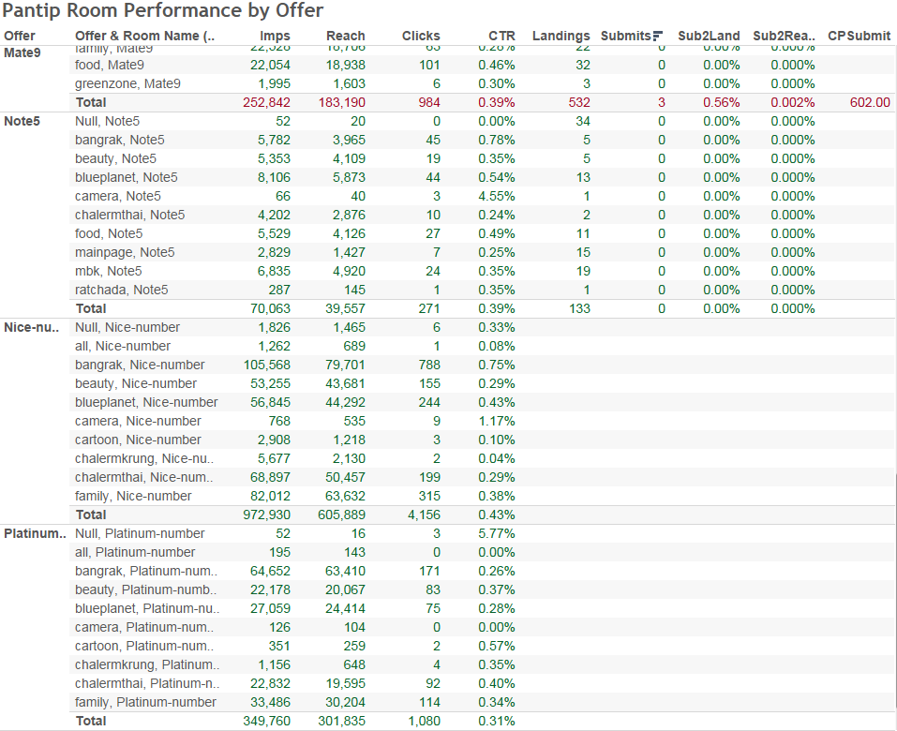
Pantip Room Performance by Offer
Relevant offers have more impact on performance than the room

Slide 20
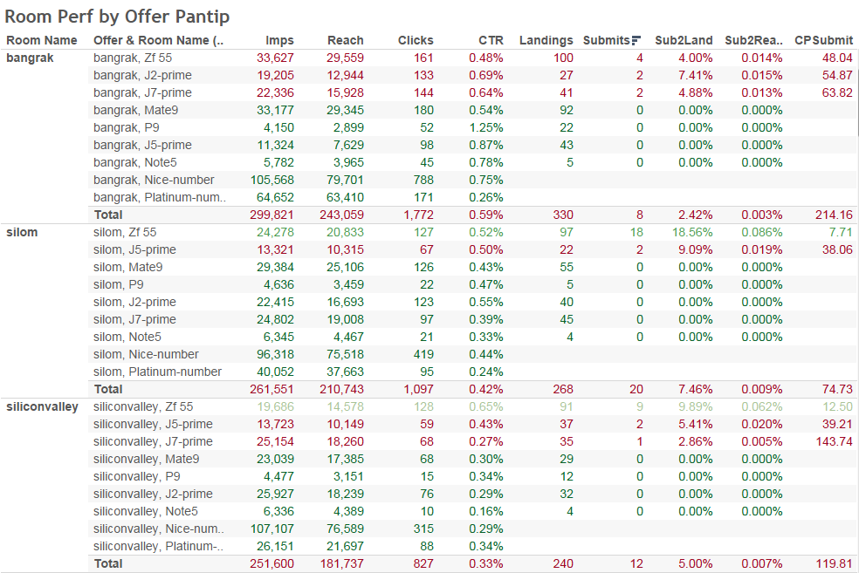
Pantip Offer Performance by Room
Relevant offers have more impact on performance than the room

Slide 21
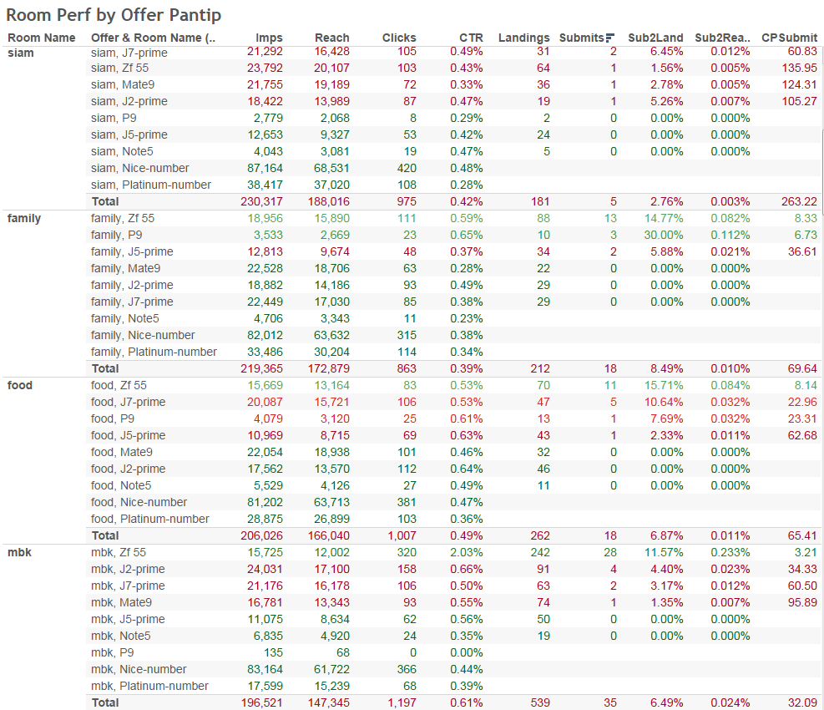
Pantip Offer Performance by Room
Relevant offers have more impact on performance than the room

Slide 22
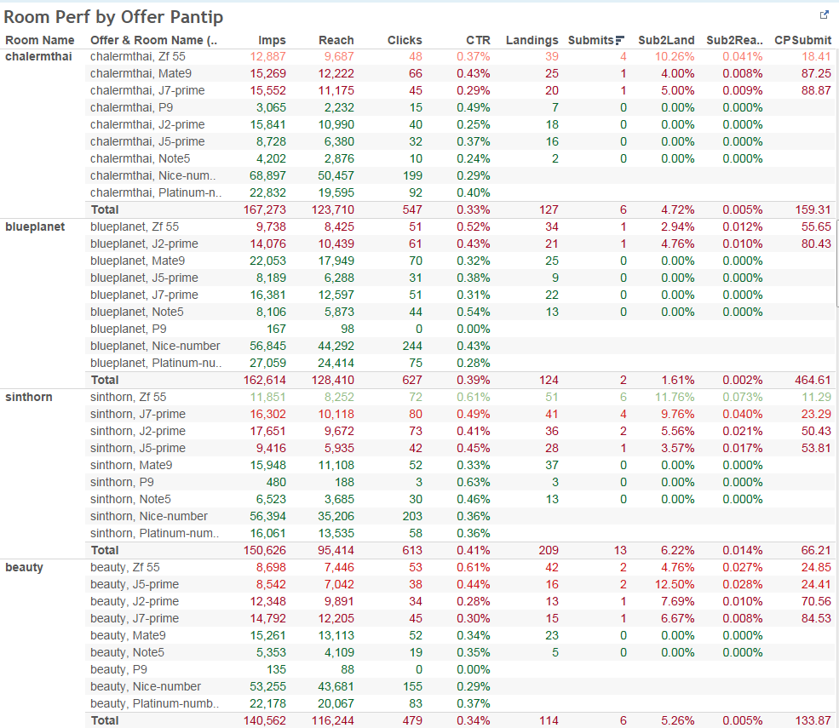
Pantip Offer Performance by Room
Relevant offers have more impact on performance than the room

Slide 23
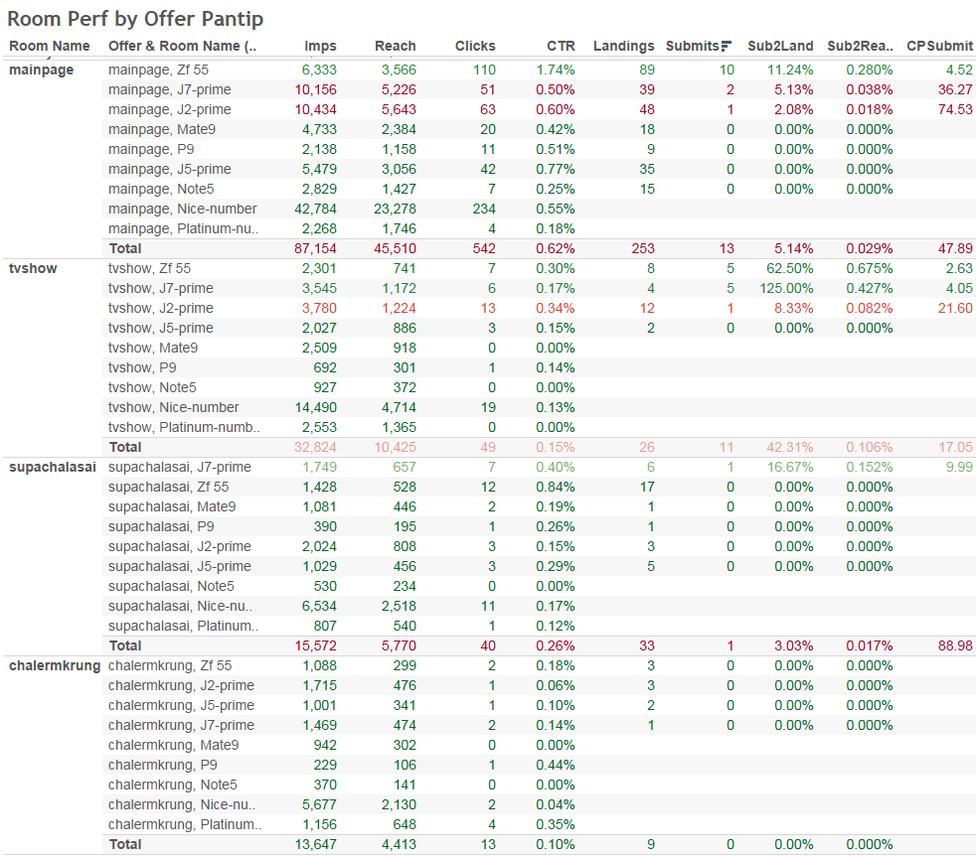
Pantip Offer Performance by Room
Relevant offers have more impact on performance than the room

Slide 24
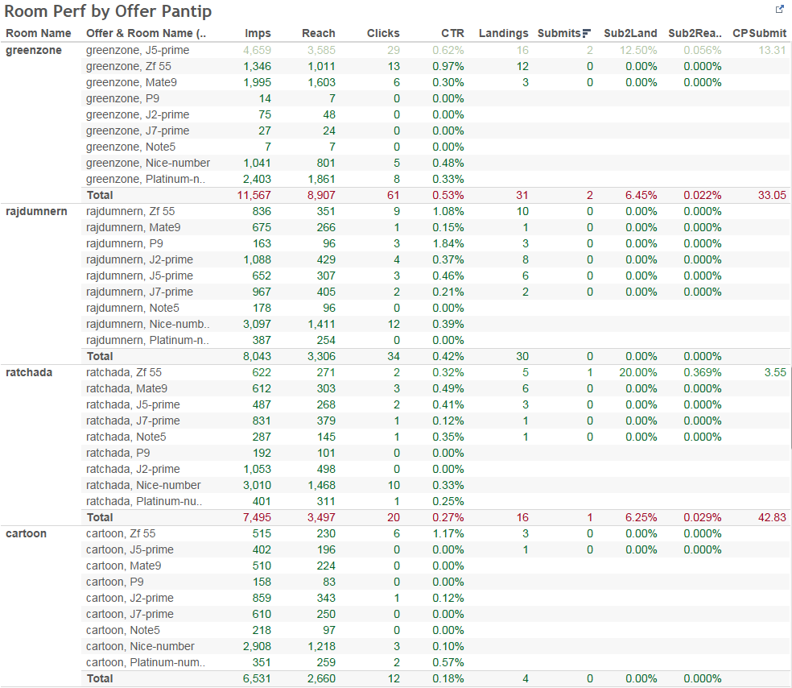
Pantip Offer Performance by Room
Relevant offers have more impact on performance than the room

Slide 25
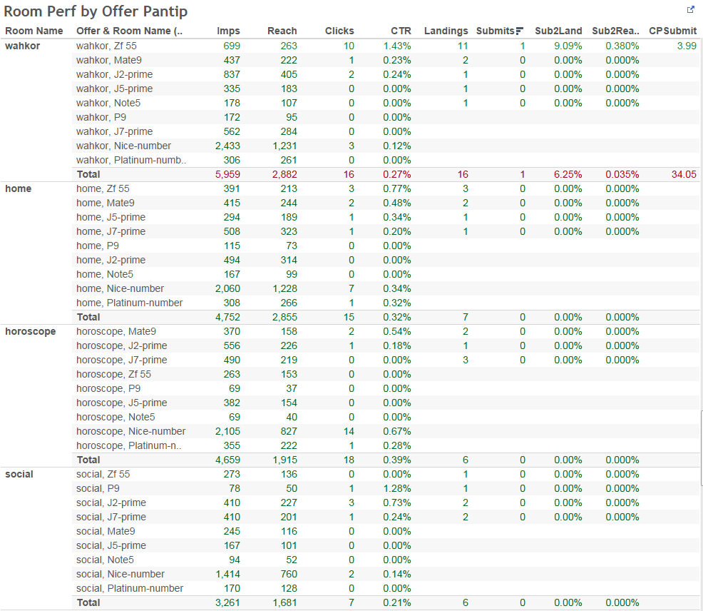
Pantip Offer Performance by Room
Relevant offers have more impact on performance than the room

Slide 26
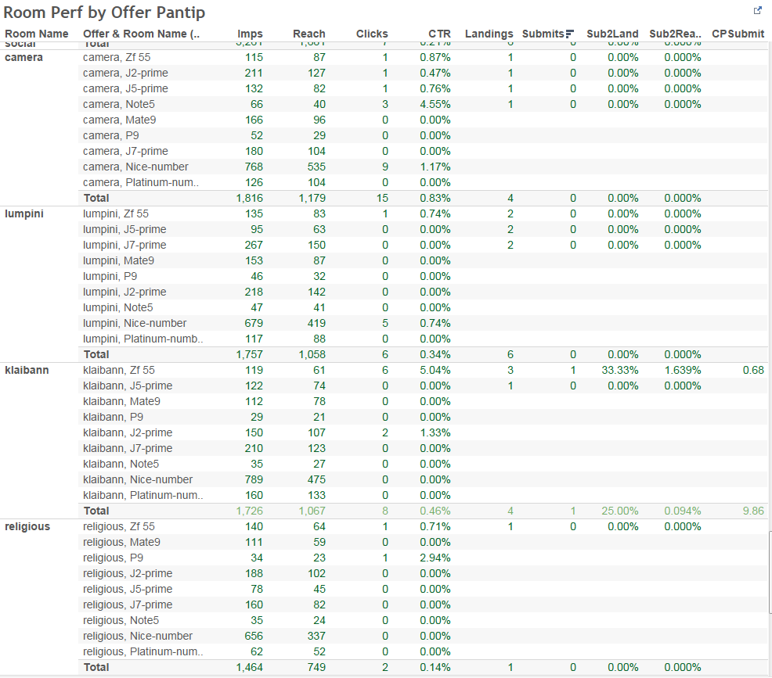
Pantip Offer Performance by Room
Relevant offers have more impact on performance than the room

